Slide 1
Welcome to VETERAN READINESS & EMPLOYMENT

Slide 2

Chapter 31 Services
Veteran Readiness and Employment (VR&E)
If you have a service-connected disability that limits your ability to work or prevents you from working VR&E can help. Educational and Career/Vocational Counseling services is a great opportunity for Veterans and Servicemembers to get personalized counseling and support to help guide their career paths, ensure most effective use of their VA benefits, and achieve their goals.
Who May Apply
Transitioning Servicemembers who are within six months prior to discharge from active duty
Veteran within one year following discharge from active duty
Any Servicemember/Veteran currently eligible for a VA education benefit
All current VA education beneficiaries

Slide 3
VR&E Program Intent
Provide services to assist Veterans and Servicemembers with service-connected disabilities to succeed:
In transition … through services to support transition back to civilian life
At work … through services resulting in suitable employment
On campus … through services to support them during education and training
At home … and in their communities … through services to maximize independence in daily living

Slide 4
VR&E Eligibility Criteria
Veterans:
Honorable or other than dishonorable discharge
A VA service-connected disability rating of 10 percent or more; or memorandum rating of 20 percent
Apply for Veteran Readiness and Employment benefits
Active Duty Servicemembers:
Expect to receive an honorable discharge
Obtain a VA memorandum rating of 20 percent or more
Obtain a Proposed Disability Evaluation Service (DES) rating
Servicemembers awaiting discharge due to a medical condition resulting from a serious injury or illness that occurred in the line of duty may be automatically entitled to VR&E benefits under the National Defense Authorization Act (NDAA) of 2008.
Apply for Veteran Readiness and Employment benefits
Notes:
Eligibility does not mean entitled. Entitlement is not automatic – Not based on percentage of service-connection

Slide 5
VR&E Basic Benefit Information
A maximum of 48 months of entitlement
May be utilized within 12 years from the date of initial VA disability rating notification. The 12-year period begins on the latter of these dates:
Note: Effective January 5, 2021, the 12-year eligibility period does not apply to claimants who were discharged or released from active military service on or after January 1, 2013.
Date of separation from active military duty, or
Date when the Veteran was first notified of a service-connected disability rating
Exception for Veterans with a Serious Employment Handicap

Slide 6
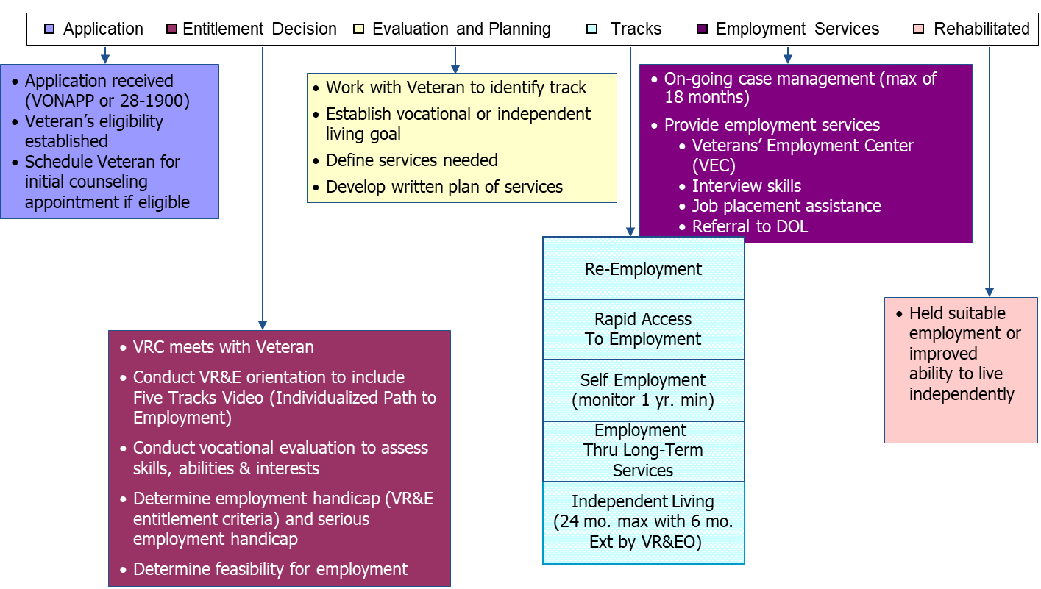
VR&E Process

Slide 7
5 Tracks to Employment
Re-employment – Return to work previously held (USERRA)
Rapid Access to Employment – Obtain employment quickly as possible
Employment through Long-Term Services – Majority of Veterans pursue
Independent Living Services – Veterans who cannot pursue vocational goal but need assistance with daily living and independence
Self-Employment - claimants who have the necessary job skills to start a business and for those who have limited access to traditional employment or require a more accommodating work environment due to the effects of a disability. Most difficult track for Veterans
Notes:
The purpose of a reemployment rehabilitation plan is to provide the services necessary for the claimant to return to work in the job held prior to entering active duty. It is not uncommon for the claimant to require some short-term training or the opportunity to refresh his or her skills prior to the delivery of employment focused services. Therefore, the rehabilitation plan is developed as either an IWRP or a combined IWRP/IEAP. Similar to the rapid access to employment plan, the only time it is permissible to develop the plan solely as an IEAP is when the individual was a prior claimant of a vocational rehabilitation program and requires only a program of employment services, as outlined in 38 U.S.C. 3117 and described in section 7.02.e
The purpose of a rapid access to employment rehabilitation plan is to provide the services necessary for the claimant to obtain and maintain employment as quickly as possible. It is not uncommon for the claimant to require some short-term training or the opportunity to refresh his or her skills prior to the delivery of employment focused services. Therefore, the rehabilitation plan is developed as either an IWRP or a combined IWRP/IEAP.
The purpose of an employment through long-term services rehabilitation plan is to provide an extended period of training and rehabilitation services to ensure the claimant has the skills necessary to obtain and maintain suitable employment. Employment through long-term services rehabilitation plans are developed and documented in an Individualized Written Rehabilitation Plan (IWRP) or a combined IWRP/Individualized Employment Assistance Plan (IEAP) format.
An Individualized Independent Living Plan (IILP) may be provided to claimants who cannot pursue an employment or vocational goal due to the limitations of their service-connected disability(ies) (SCD) to enhance activities of their daily living and independence from their family and community.
Claimants who have the skills and interest to start a business may benefit from a self-employment plan. The purpose of the self-employment track is to provide services to claimants who have the necessary job skills to start a business and for those who have limited access to traditional employment or require a more accommodating work environment due to the effects of a disability.

Slide 8
VR&E Benefits and GI Bill
Is the VR&E Program the same as the GI Bill?
No. GI Bill is an educational program.
The purpose of the VR&E Program is to help Veterans with service-connected disabilities and barriers to employment to become suitably employed.
Four of the Five VR&E Tracks of Services are geared specifically toward employment
The “E” in VR&E stands for the program’s mission to assist Veterans and Servicemembers with obtaining suitable Employment.
Notes:
VR&E is an employment focused program
VR&E uses education as a tool/service to achieve employment

Slide 9
VR&E Employment Focus
The VR&E Program provides employment services in four of the five rehabilitation tracks. Personalized employment services may include:
Work-readiness preparation
Resume development and job-seeking skills
Employment resources development
Job accommodations
Job placement assistance
Post-Employment Follow-up
Evaluation of your abilities, aptitudes, and interests
Career counseling and rehabilitation planning

Slide 10
VR&E Employment Focus
Other Employment Services may include:
Referrals to other employment resources
Veterans Employment Center (VEC)
Online tools that connects Veterans and employers
Access through https://www.va.gov/
Department of Labor (DOL)
Employment Assistance
Disabled Veterans’ Outreach Program Specialist (DVOP)
Local Veterans’ Employment Representative (LVER)

Slide 11

Applying for Services
On-line
https://www.va.gov
Veteran Readiness and Employment Orientation | Veteran Affairs (va.gov)
Mail or deliver application to the nearest local VA Regional Office
56 Regional Offices around the US
Address:
Veterans Readiness and Employment (VR&E) Intake Center
P.O. Box 5210
Janesville, WI 53547-5210

Slide 12
The Dakotas
North Dakota and South Dakota
Regional Offices – Fargo, ND and Sioux Falls, SD
Division of 13 total employees
8 Vocational Rehabilitation Counselors (VRC)
2 Employment Coordinators
2 Admin Support Staff
1 Management Staff

Slide 13

Thank You!

